Slide 1
GUILHERME & TIAGO’S WEDDING
JUNE 6TH, 2026
100 GUESTS
YACHTS DE PARIS, PARIS
WEDDING MOOD BOARD

Slide 2
COLOR PALETTE
JUNE 6TH, 2026:
CEREMONY: WARM WHITE/YELLOW
BOUQUET: WARM WHITE/YELLOW
COCKTAIL & RECEPTION/DINNER: WARM WHITE/YELLOW
WELCOME PARTY: WARM WHITE/YELLOW

Slide 3
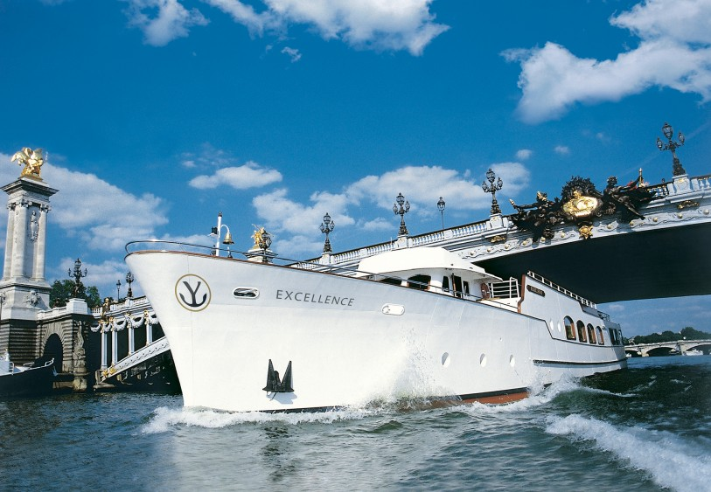
CEREMONY DECOR
The ceremony will take place at Yachts de Paris, Paris.

Slide 4
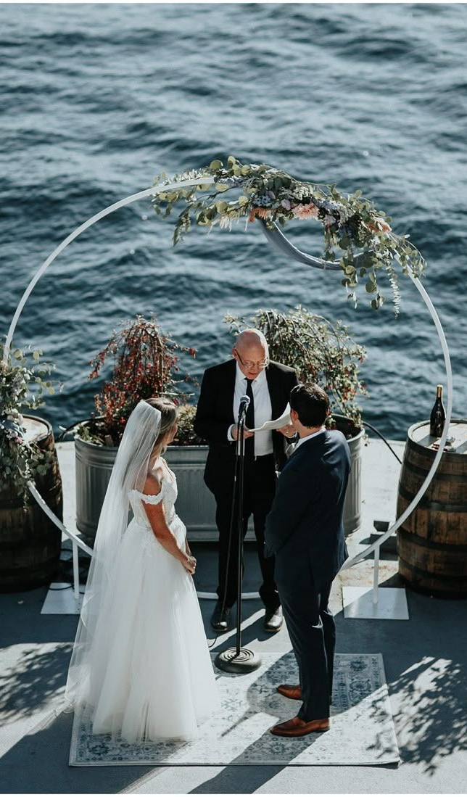
ALTAR DECOR
A modern and romantic ceremony altar featuring a sleek circular white structure softly accented with an organic floral installation across the top. Designed with airy greenery and delicate blooms in a loose, natural composition, the altar feels elegant, understated, and beautifully intentional

Slide 5
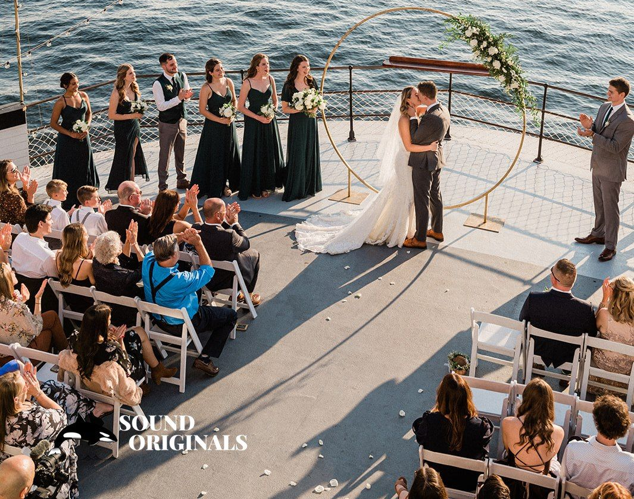
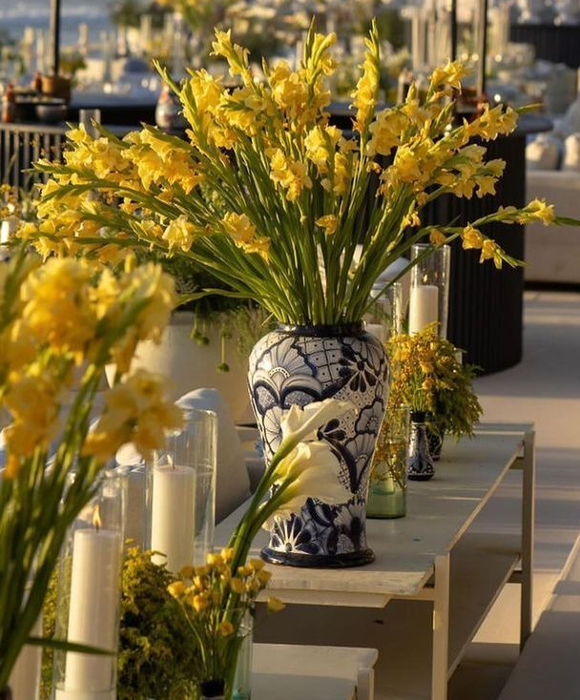
AISLE DECOR
The floral arrangements are designed in statement blue and white ceramic vases, bringing a refined yet distinctive decorative touch to the ceremony design. Each arrangement features an abundant composition of vibrant yellow blooms styled in a naturally airy and vertical shape, creating a fresh, elegant, and visually striking presence
Placed two on each side of the altar and mirrored again at the aisle entrance, these arrangements would beautifully frame the ceremony space while adding height, symmetry, and a bold yet sophisticated floral moment. The overall effect feels elevated, fresh, fashion-forward, and effortlessly luxurious

Slide 6
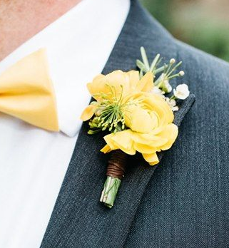
BOUTONNIERE
A fresh and cheerful boutonniere featuring vibrant yellow blooms accented with delicate textural details and subtle greenery for a refined yet playful finish. Wrapped with a natural stem binding, it brings a polished and intentional touch to the groom’s look while adding a soft pop of color. The overall aesthetic feels elegant, modern, and perfectly suited for a bright, joyful wedding palette

Slide 7
MAID OF HONOR & FLOWER GIRLS BOUQUETS
Should this be required, please inform us and include a reference image for guidance

Slide 8
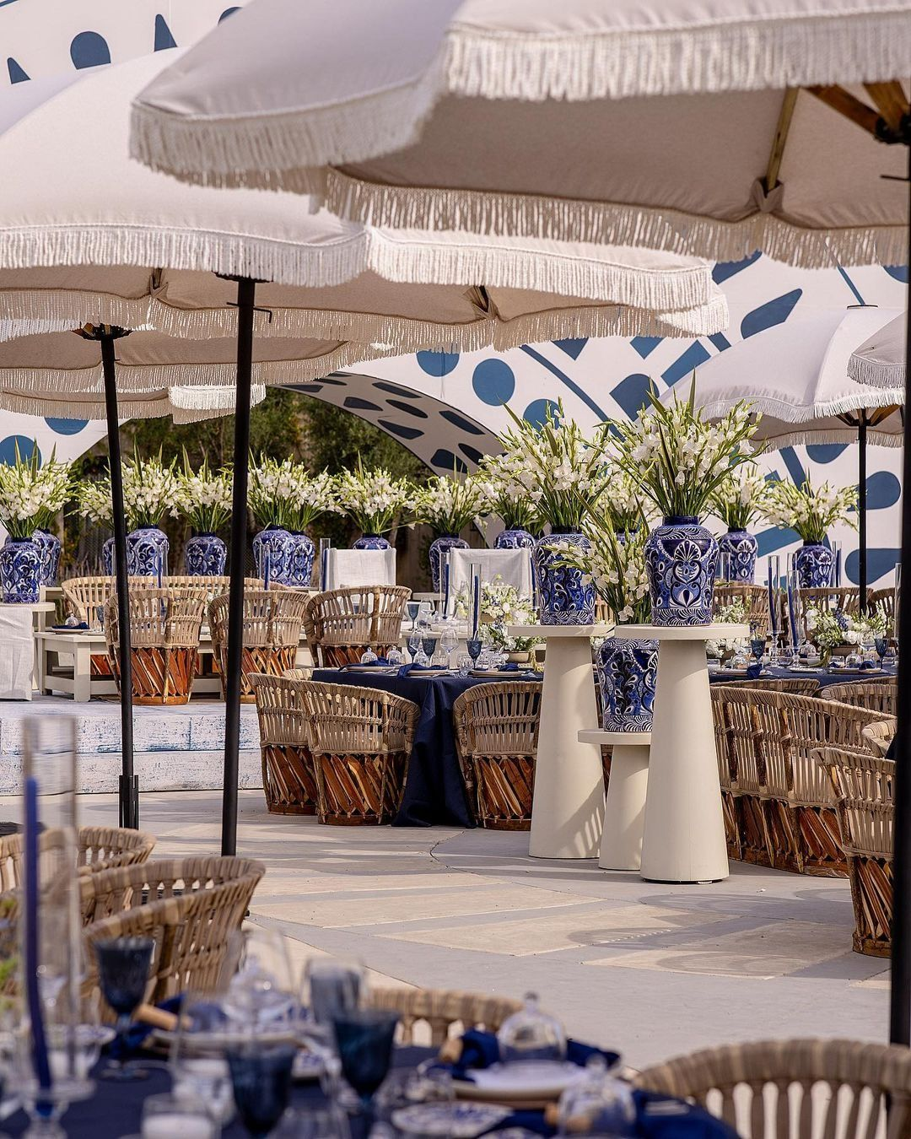
COCKTAIL
Statement blue and white ceramic vases filled with vibrant yellow blooms create a fresh, elevated, and visually striking centerpiece for the lounge tables, adding a refined and distinctive luxury touch to the overall design
The vases and floral arrangements make a strong decorative statement, featuring striking blue and white patterned ceramic vessels filled with abundant yellow and white blooms in a tall, airy composition that brings height, freshness, and a bold yet elegant visual impact to the overall design

Slide 9
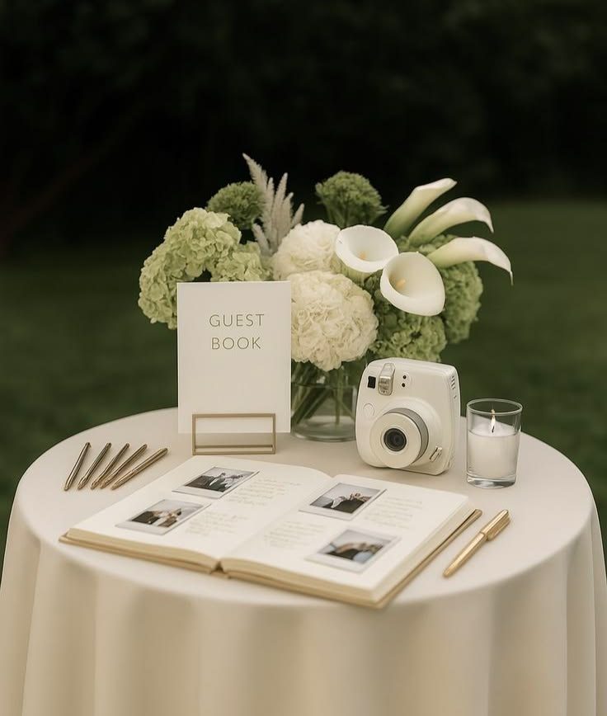
COCKTAIL – PART 2
A refined and thoughtfully styled guest book table featuring a clean, elegant setup with the guest book, pens, instant camera, and candle beautifully arranged for an elevated yet interactive experience. The floral arrangement, designed in statement blue and white ceramic vases and filled with vibrant yellow blooms, would bring a fresh, polished, and distinctive decorative touch to the table

Slide 10
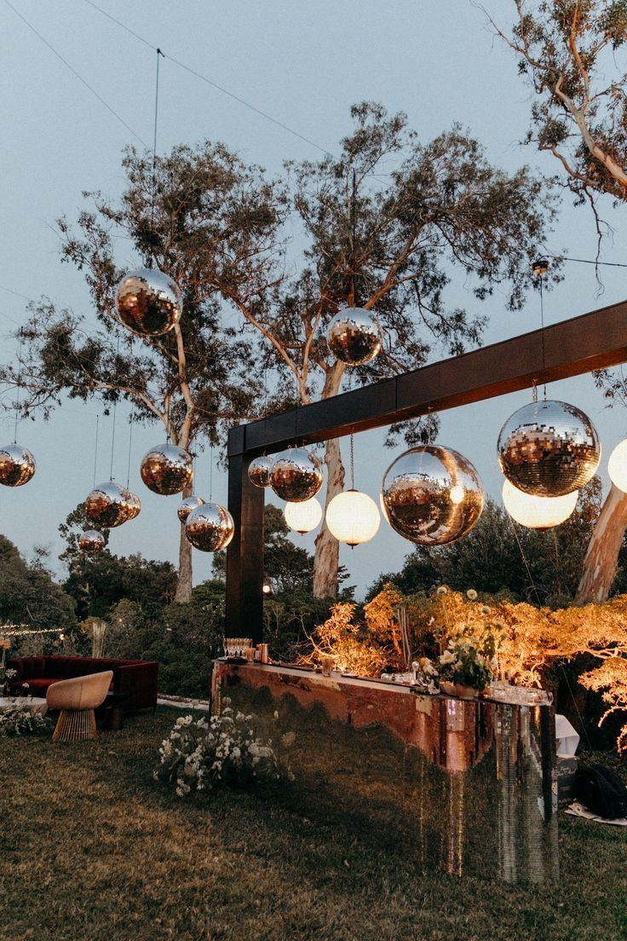
BARS RENTAL & DECOR
The wedding bar features a sleek, contemporary structure with a clean-lined frame and a reflective, mirrored façade that subtly captures the surrounding landscape and candlelight
The décor is defined by a striking installation of suspended disco balls in varying sizes, creating a bold yet sophisticated visual statement. Paired with soft globe lighting, the reflective surfaces catch and diffuse the ambient glow, adding movement, sparkle, and dimension to the space
The décor will echo the reference imagery, styled in harmony with the color palette detailed on slide #2

Slide 11
BOAT DECOR

Slide 12
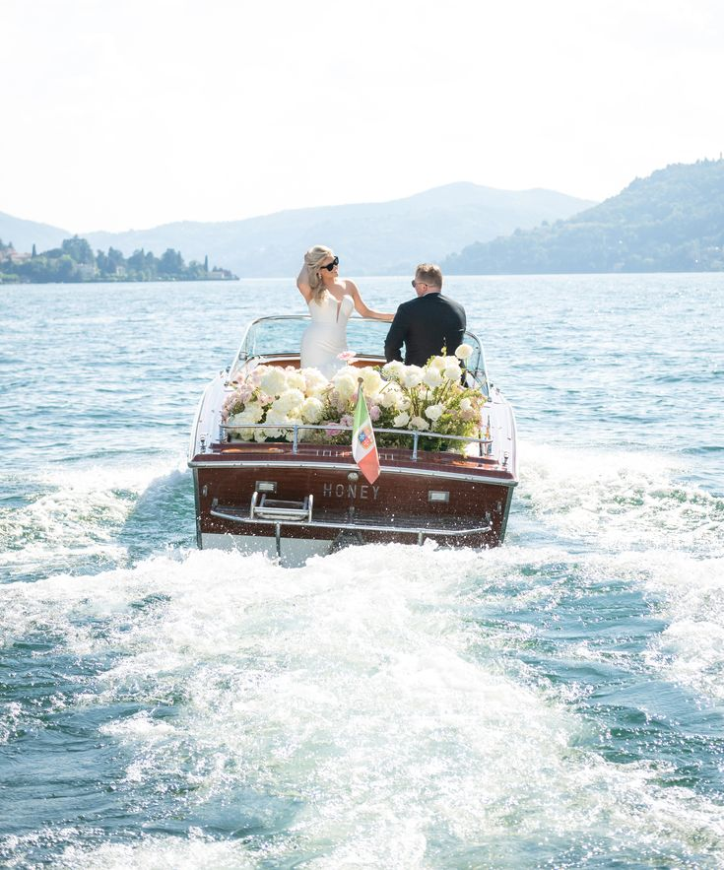
The floral arrangements on the boat feature a lush and romantic composition of soft white and light-yellow blooms, styled abundantly along the back of the boat for an effortlessly elegant effect. The design feels fresh, airy, and refined, adding a graceful floral touch that enhances the overall luxurious and cinematic feel of the moment

Slide 13
SIGNS

Slide 14
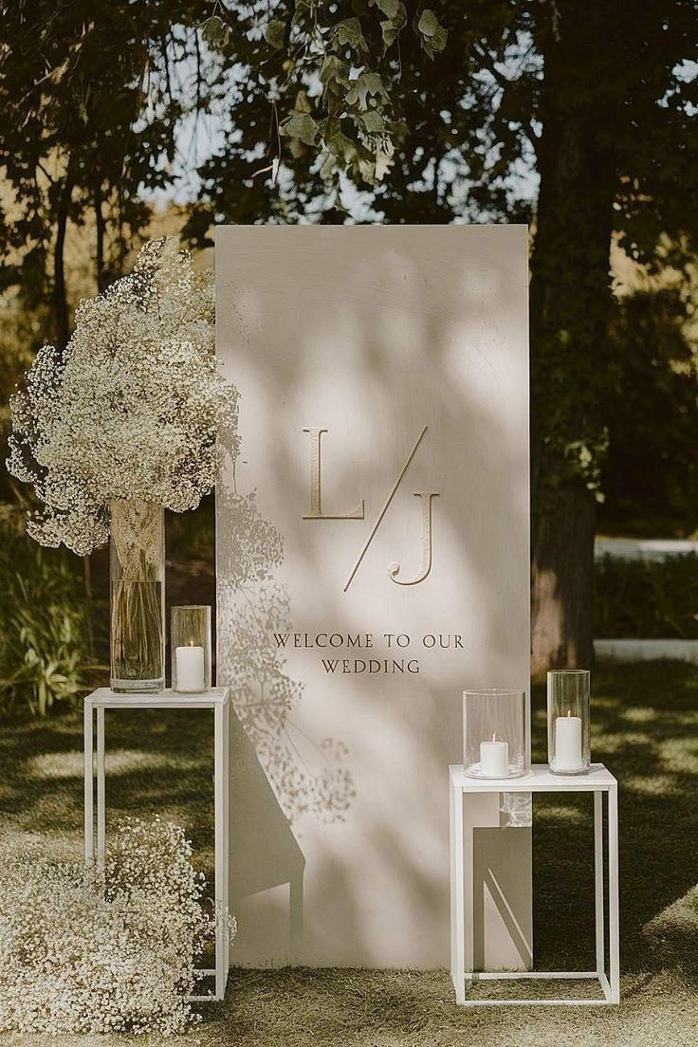
Welcome Sign & Décor
The wedding welcome sign features a clean and contemporary freestanding design with a soft ivory finish and an understated, elegant layout. The typography is minimal and refined, creating a timeless first impression that feels polished, modern, and effortlessly sophisticated
Styled with yellow floral arrangements displayed in tall ceramic vases for a delicate yet impactful effect, accompanied by candles in varying sizes to create a warm, refined, and beautifully layered presentation

Slide 15
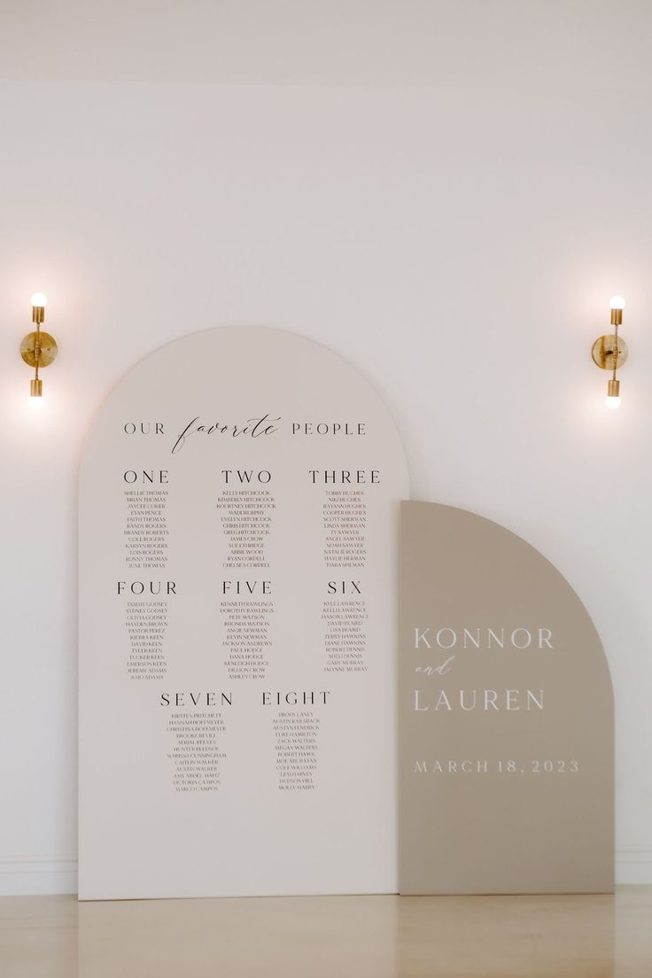
Seating Chart
This wedding seating chart features a modern and architectural design with softly curved panels in warm neutral tones, creating a clean and elevated visual statement. The layout is thoughtfully structured with refined typography, pairing a delicate script with a minimalist serif font for a timeless and sophisticated look

Slide 16
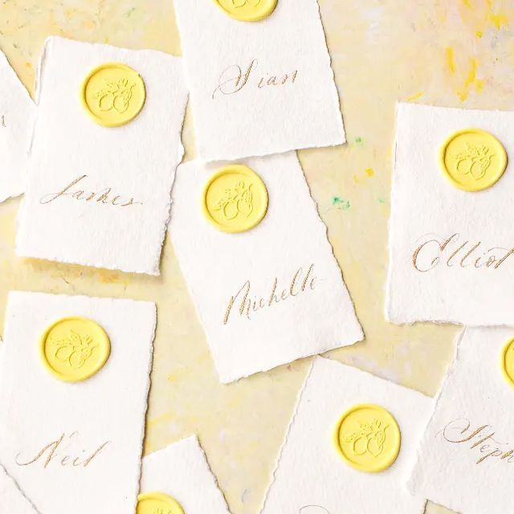
Place Cards
Audrey’s Note:
Please note that place cards are required by the catering staff regardless of round or rectangular tables. For weddings with more than 100 guests, place cards must be placed on each table with assigned seating, showing each guest’s full name, table number, and a meal icon/allergy note to guide the staff.

Slide 17
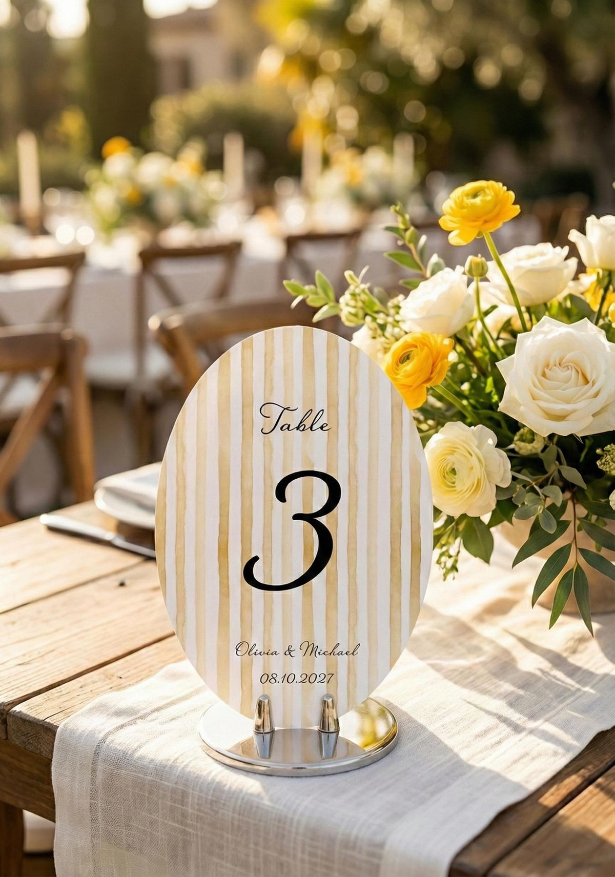
Table numbers
This wedding table number features an elegant oval design with soft ivory and light-yellow stripes, paired with refined typography for a timeless and elevated look. Displayed on a polished stand, it adds a chic and beautifully curated touch to the overall tablescape

Slide 18
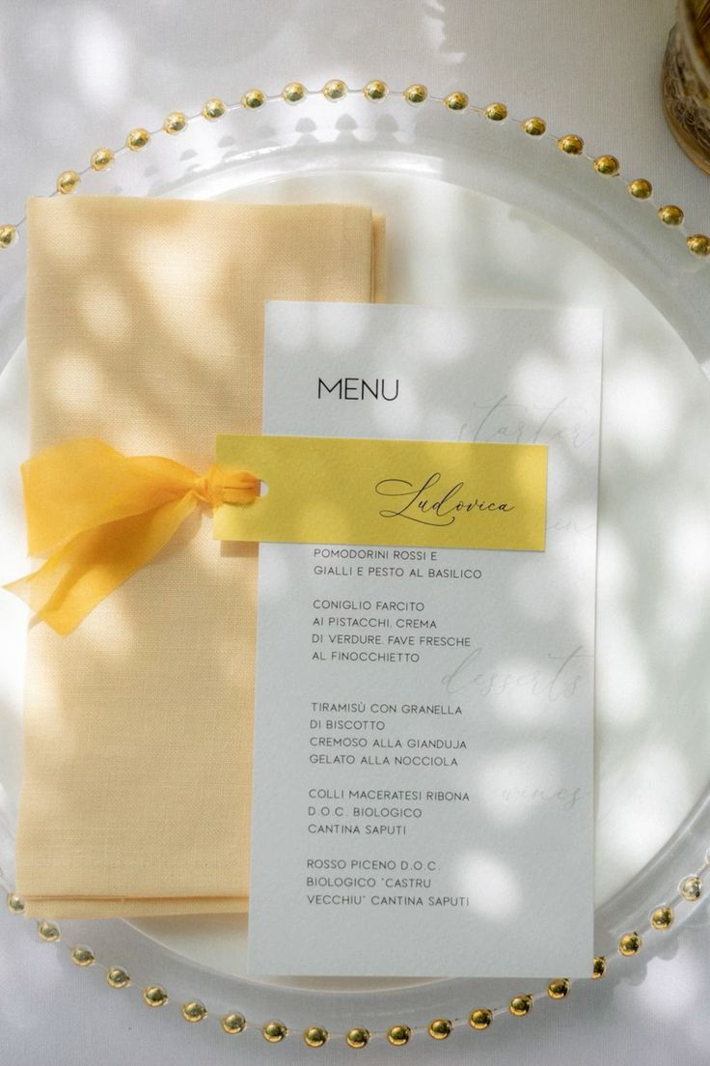
Menus
This wedding menu features a clean and refined design with soft, minimal typography on crisp white paper. It is paired with a delicate light-yellow napkin and a matching name card tied with a chiffon ribbon, creating a fresh, elegant, and thoughtfully coordinated place setting
Audrey’s note: To ensure visual consistency across the menus, place cards, and table numbers, the same font and color palette will be applied throughout. I would also recommend opting for a lace ribbon rather than satin to better complement the table numbers. Final details to be confirmed with Kiara.

Slide 19
RECEPTION DÉCOR
The ceremony will take place at Yachts de Paris, Paris.

Slide 20
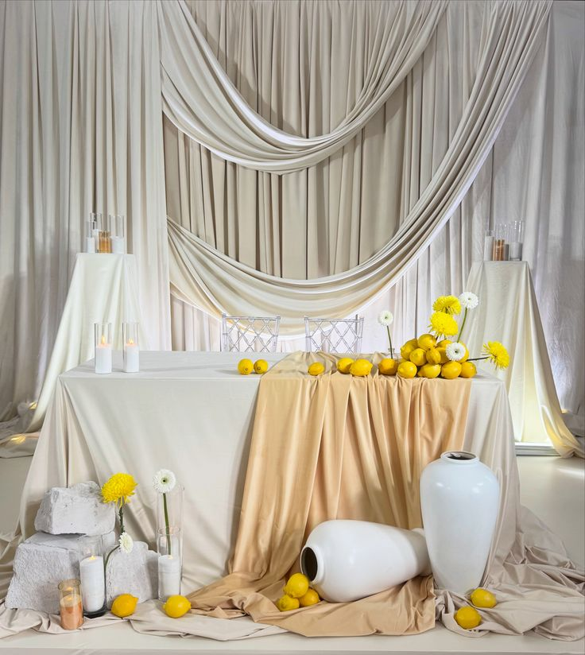
Groom & Groom – Table For 2
The groom and groom table features a modern and editorial-inspired design with soft ivory and champagne-toned draping layered throughout for a sculptural and elevated effect
The floral arrangements are kept minimal yet impactful, featuring bright yellow and soft white blooms styled in a clean, airy way throughout the table and surrounding décor
The vases feature a sleek, oversized ceramic design in a crisp white finish, adding a bold and sculptural decorative element to the overall styling
Every detail is thoughtfully curated to harmonize seamlessly with the color palette detailed on slide #2, resulting in a warm, refined, and unforgettable focal point

Slide 21
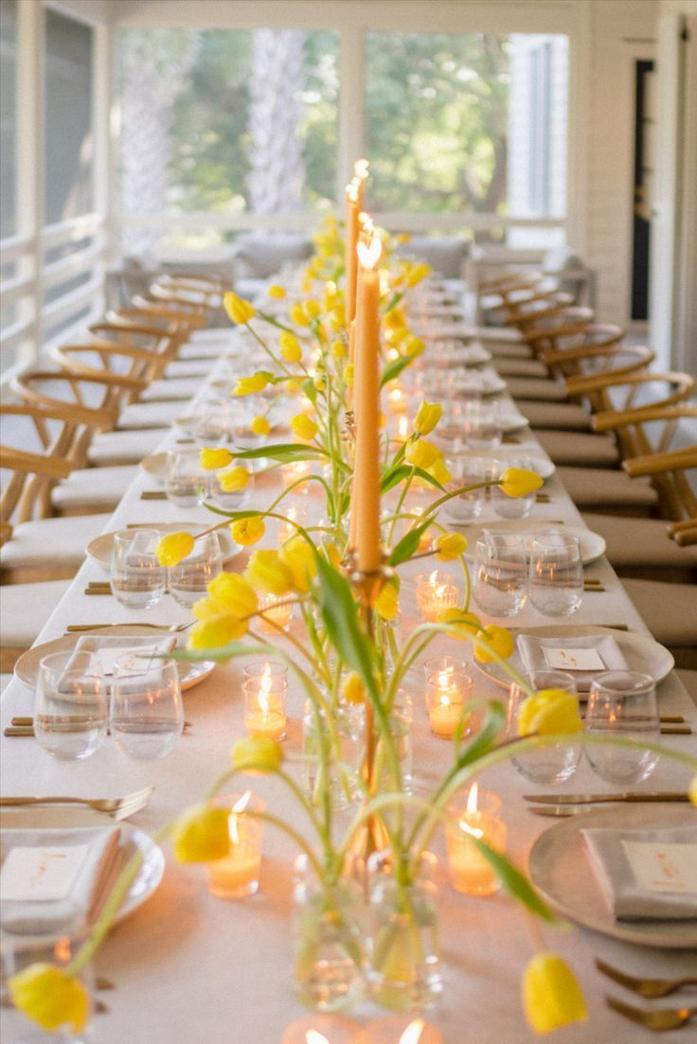
Rectangular Tables – OPTION 1
This wedding reception table features a clean and elegant long-table design styled with a soft, refined tablescape and a fresh, airy floral runner. Delicate yellow blooms arranged in bud vases create a light and playful yet sophisticated look, while taper candles and scattered votives add warmth and a romantic glow throughout the table
The overall décor will reflect and harmonize with the color palette detailed on slide #2

Slide 22
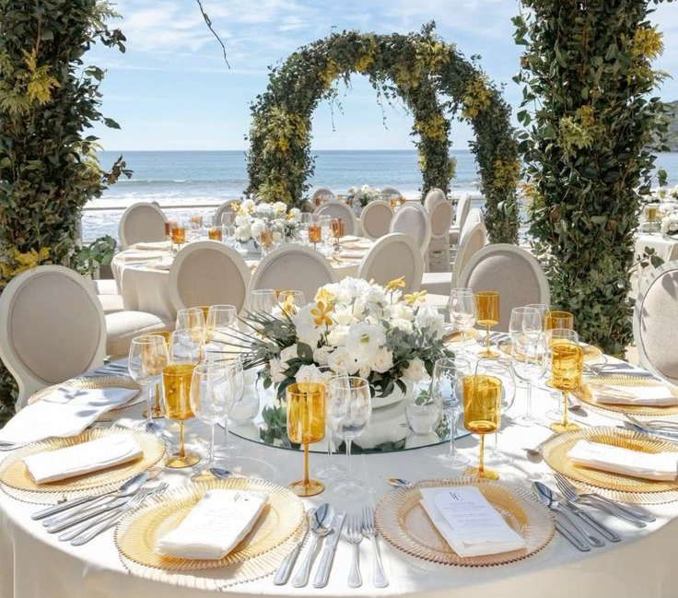
Round Tables – Option 2
This wedding reception table features an elegant and refined round design with a bright, polished, and beautifully balanced overall look. At the center, a fresh floral arrangement in soft white and yellow tones brings lightness, softness, and a subtle touch of color to the design. The overall aesthetic feels chic, coastal, and effortlessly luxurious

Slide 23
RENTALS

Slide 24
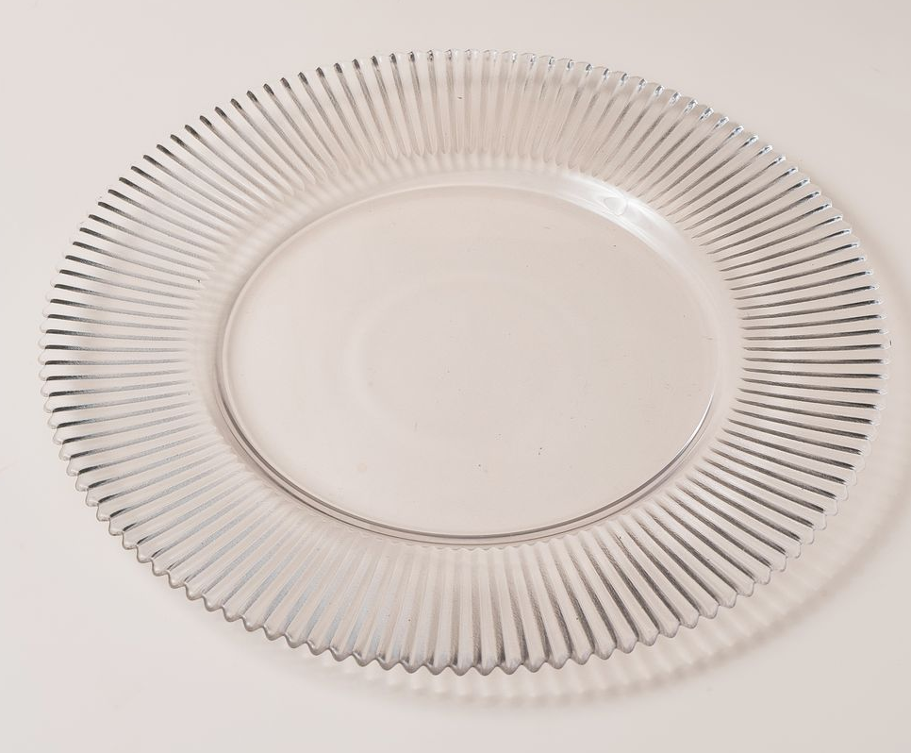
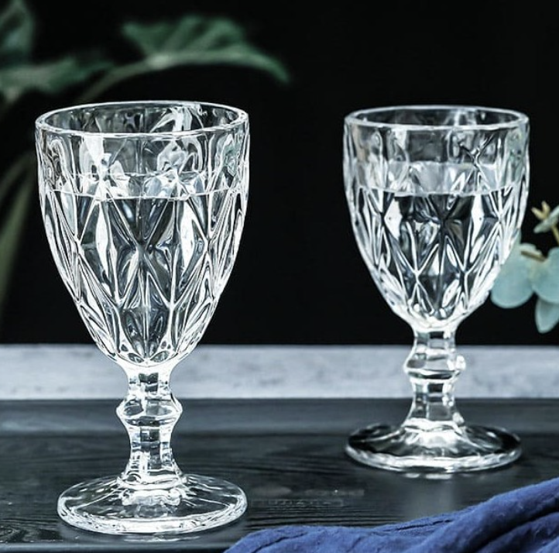
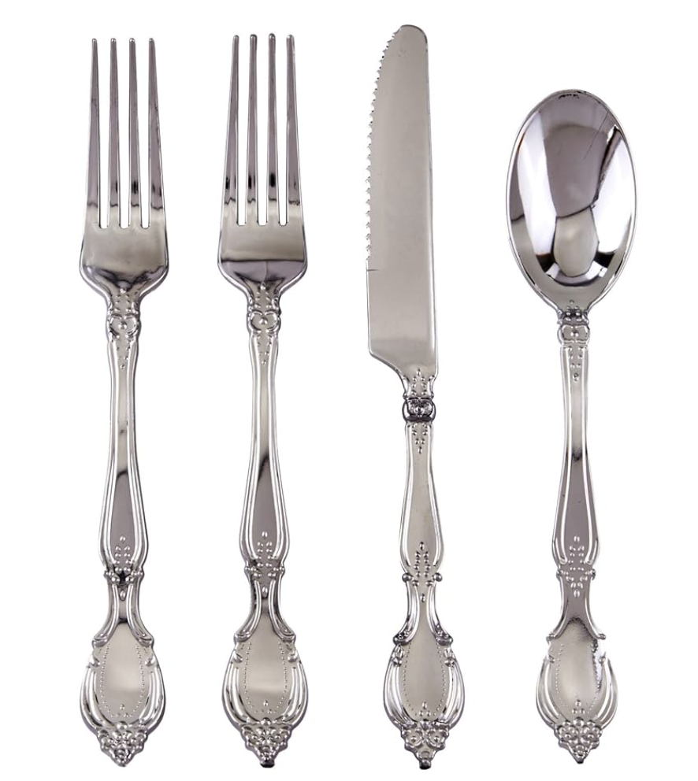
TABLEWARE
Transparent charger plates will be selected based on rental availability and chosen to reflect the bride’s reference image as closely as possible. Vintage silver flatware will complement the overall table setting, paired with delicate crystal glassware and soft light yellow napkins to create a refined, elegant, and harmonious tablescape

Slide 25
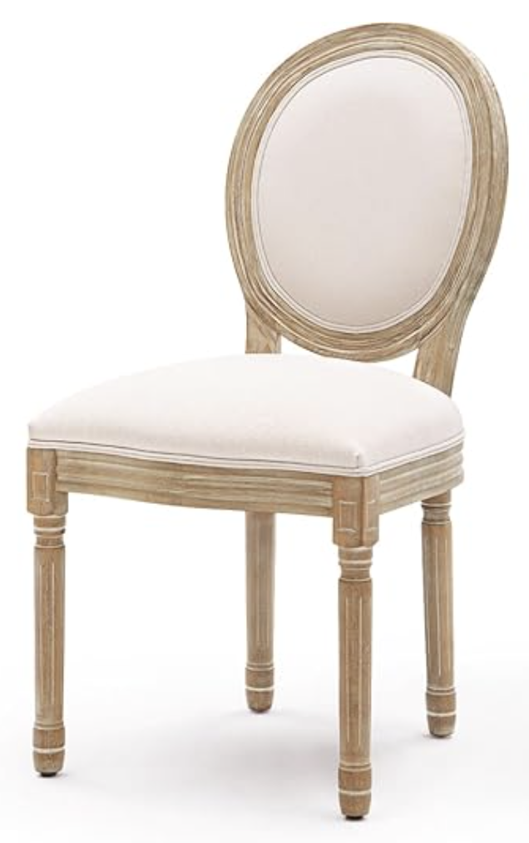
CHAIRS FOR
RECEPTION
WOODEN - Louis Chairs

Slide 26
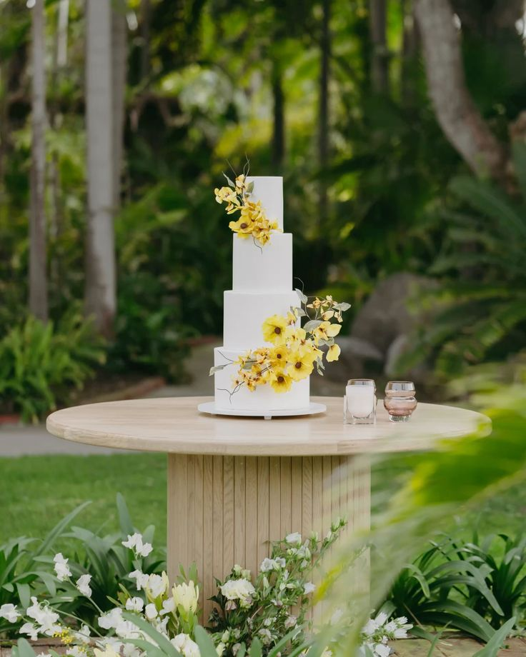
CAKE TABLE
This wedding cake table features a clean and minimalist round design in a natural light wood finish, bringing a soft, organic, and elevated feel to the overall setup. Its sculptural pedestal base adds subtle architectural interest while keeping the look refined and modern

Slide 27
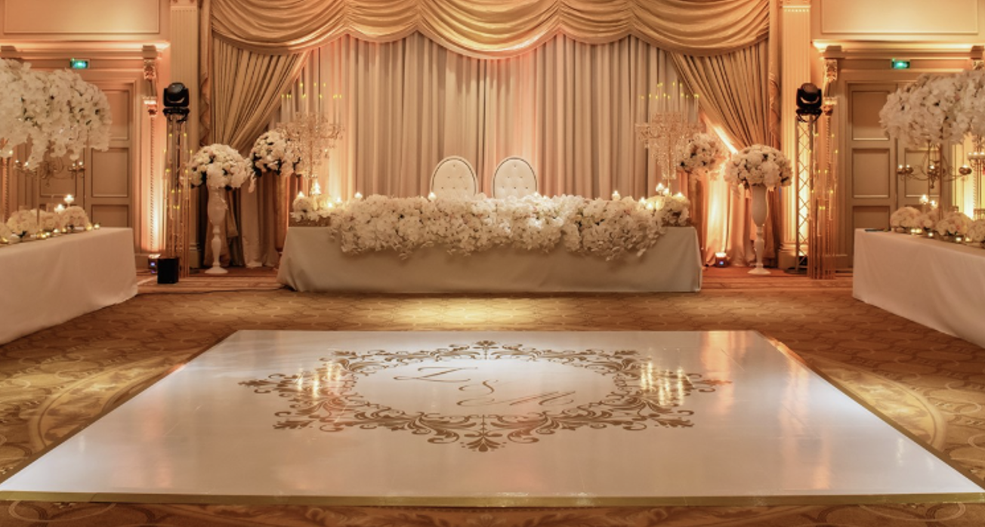
DANCEFLOOR
The dance floor provided by the Shangri-La will be glossy white and wrapped with gold foil, exactly as shown in the reference image, featuring a similar logo with the initials G & T and the date 6.06.2026.

Slide 28
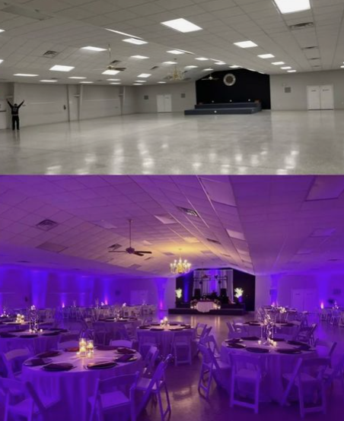
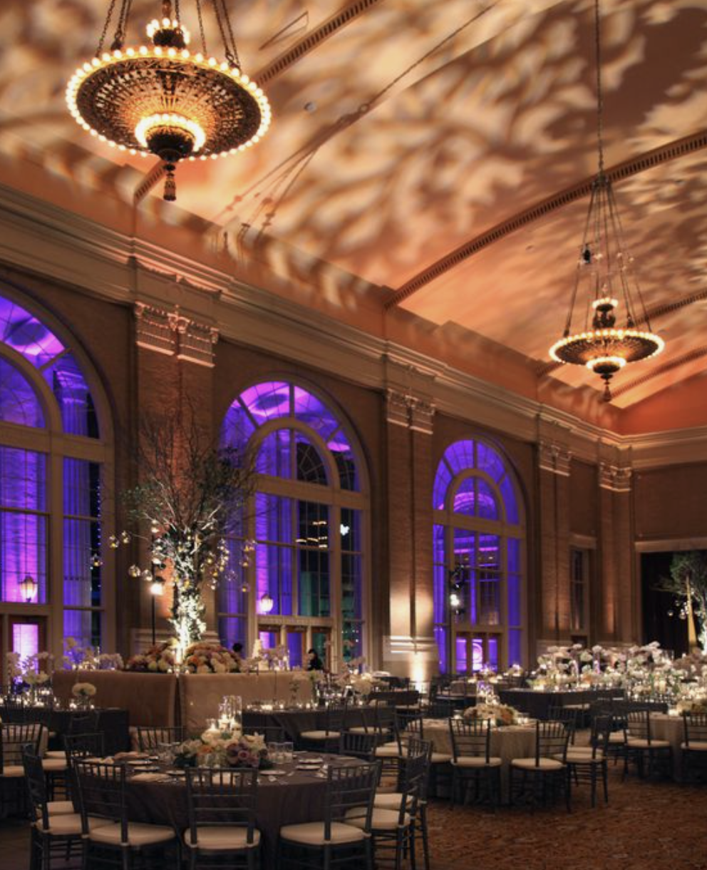
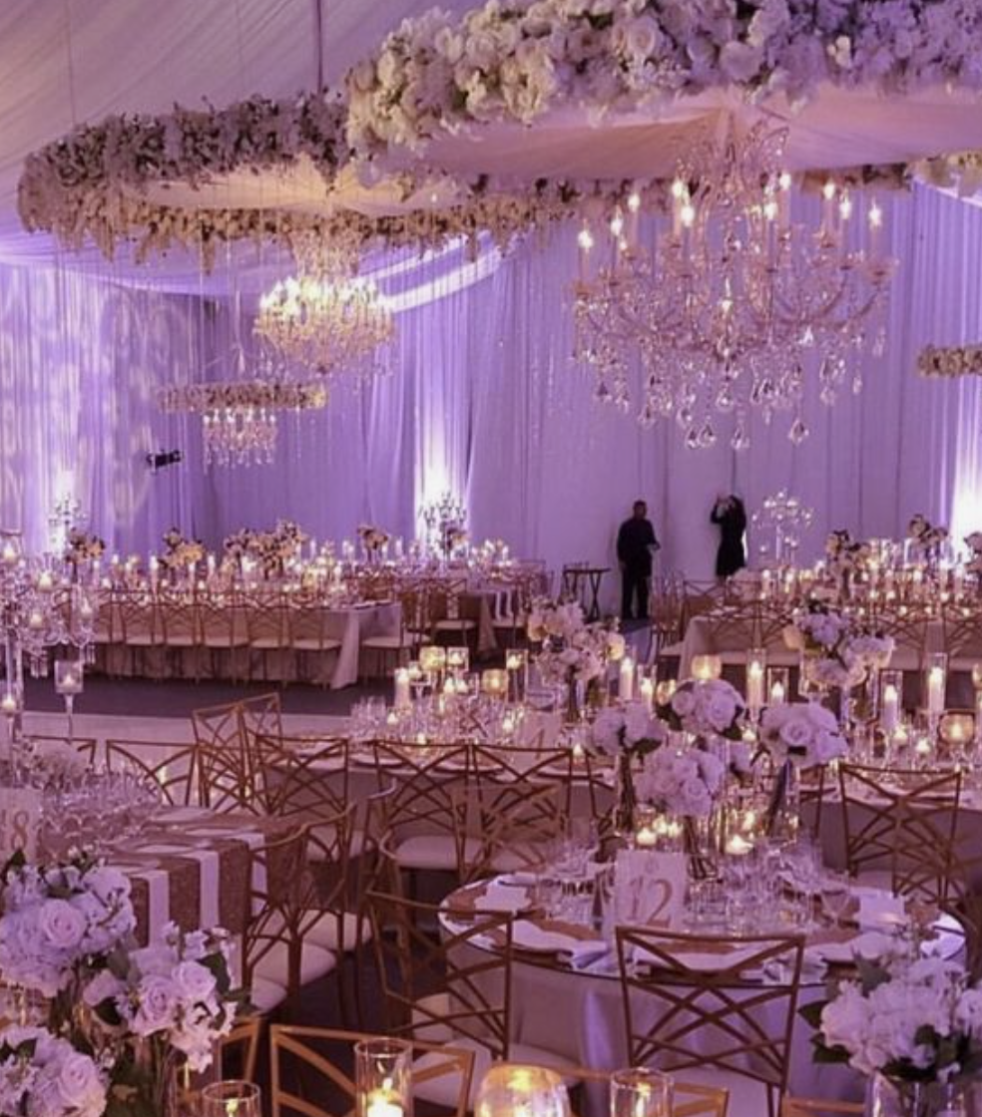
UP LITHING
Audrey’s Note: I highly recommend considering uplighting for your décor. It has a remarkable ability to enhance the overall ambiance by highlighting key elements and adding warmth to the space. Uplighting can truly transform your event, creating a captivating and inviting atmosphere that your guests will love.

Slide 29
FLOOR PLANS

Slide 30
RECEPTION/DINNER SEATING PLAN
The finalized floor plan will be shared upon confirmation of the final guest list and type of tables.

Slide 31
WELCOME DINNER
The welcome dinner will take place at TBD.

Slide 32
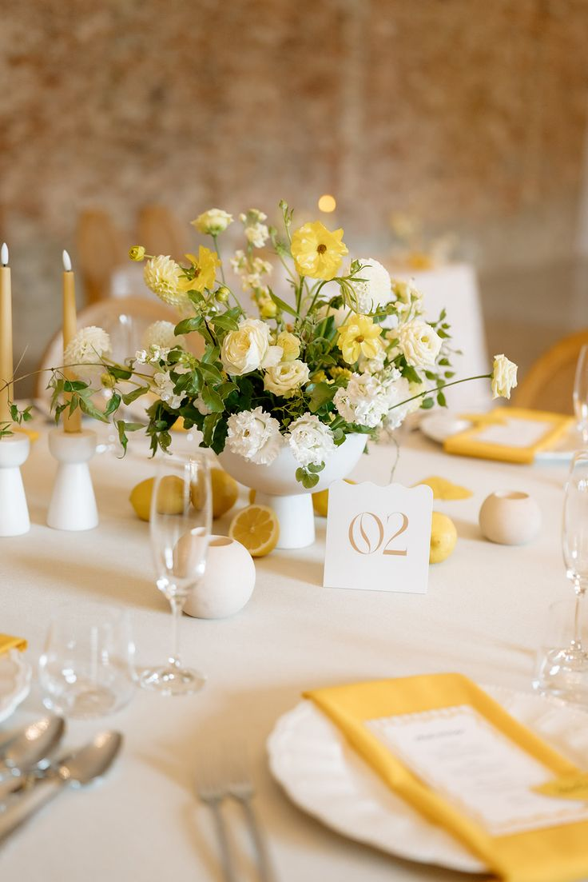
This centerpiece features a fresh and elevated floral composition designed in a soft ivory pedestal bowl for a refined yet effortless look. The arrangement blends soft white and vibrant yellow blooms in an airy, garden-inspired shape, creating movement, lightness, and a cheerful touch of color

Slide 33
We can’t wait to bring your vision to life!
The concepts (written and images) in this proposal are symbolic of the design inspiration we intend to bring to life for your event. Due to the characteristics of perishable items (flowers), there can be situations that may emerge that are completely out of our control.
To protect the integrity of our creativity, we kindly ask that you do not share the details of this proposal with other vendors bidding for your event. This was made just for you. However, please feel free to share this with your family.

Slide 34
NOTES FOR PLANNER AND FLORIST TEAM ONLY (FRENCH):
Décor de la ceremonie
1 Bouquet de mariée
1 Boutonnière du marié
1 Boutonnière pour le Best man – différente de celle du marié mais dans le meme style
1 Bouquet de demoiselles d'honneur – qu’avec des roses par d’orchidées
3 Bouquet de flower girls - qu’avec des roses par d’orchidées mais plus petit que celui de la demoiselle d’honneur
Décor de la Cérémonie + décor de l’allee a l’Eglise – Nous n’avons que 20min max pour l’installation et a peine 5-10min apres la ceremonie avant la messe…
8 tables ronde (jusqu'à 10 invités par table) Nombre final a determiner
2 longue tables rectangulaire de 28 personnes (soit 14 de chaque coté)
6 décor Tables mange debout pour l'heure du cocktail
2 Décor de Bars (1 pour le cocktail - 1 pour la réception/fête)
1 décor pour le welcome sign / panneau de bienvenue
1 décor pour la Table “Welcome” Table
Re disposition des fleurs pour la table du Wedding Cake
1 décor pour la table buffet de dessert + drape blanc comme sur la photo
REHEARSAL DINNER
8 tables – 6-8 petit vase “single flowers” par table – Décor blanc, differente fleurs de saison - Comme sur la photo

